Slide 1

EN.580.428 Genomic Data Visualization Lesson 1 Intro to Data Visualization Theory
Prof. Jean Fan

Slide 2
Announcements
Intro: Caleb
Office Hours after class MW in Wyman CCB
walk with Caleb/Prof. Fan after class
Reach out to schedule alternative times (in person or via Zoom)
Bio-break at ~9am before hands-on coding component
HW0 was due yesterday but if you haven’t done it, please turn it in late
In general, late (Github pull timestamp), will result in a deduction
Again, you can turn it in earlier
Pre-course Survey on Canvas, please do it if you haven’t already since we will use this information to put you into groups for projects

Slide 3
Lesson learning objectives
Establish a common vocabulary for discussing data visualization
To be able to communicate with each other about properties of data visualization
Be interactive
Begin programming in R

Slide 4
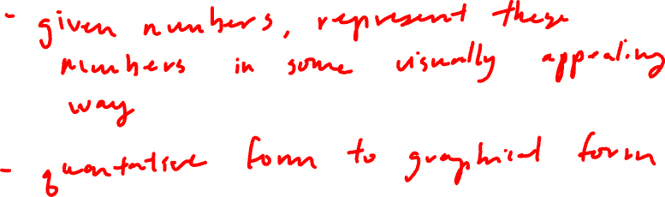
What is data visualization?

Slide 5
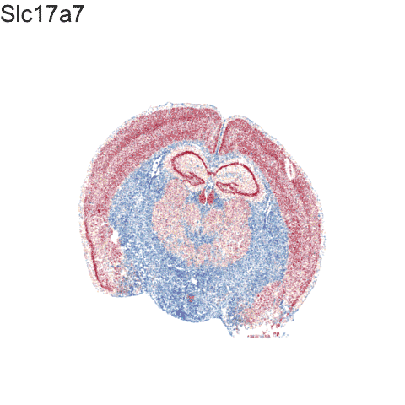
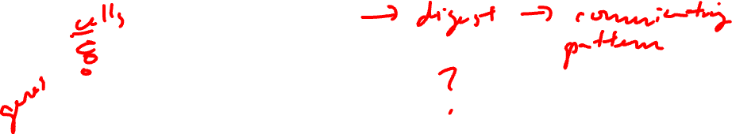
What is data visualization?
Data visualization == “the graphical display of data”

Slide 6
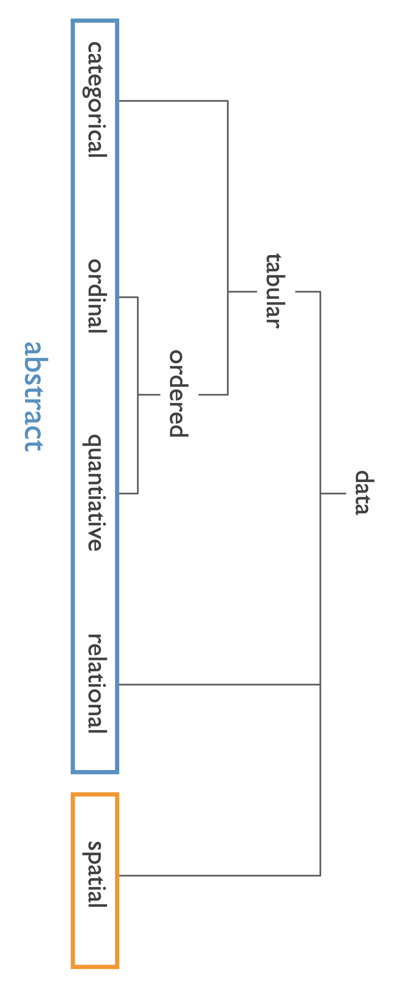
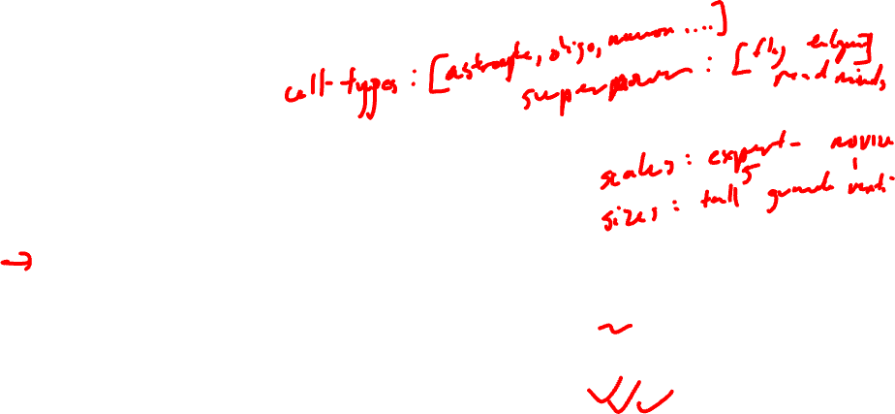
Data types
Categorical data represent qualitative characteristics. Categorical data can take on numerical values, but those numbers don’t have mathematical meaning.
Ordinal data represent mixes numerical and categorical data. The data fall into categories, but the numbers placed on the categories have meaning.
Quantitative data represent numerical values. Values can be interpreted mathematically.
Relational data represent how numerical and categorical data are related
Spatial data represents information about the physical location and shape

Slide 7
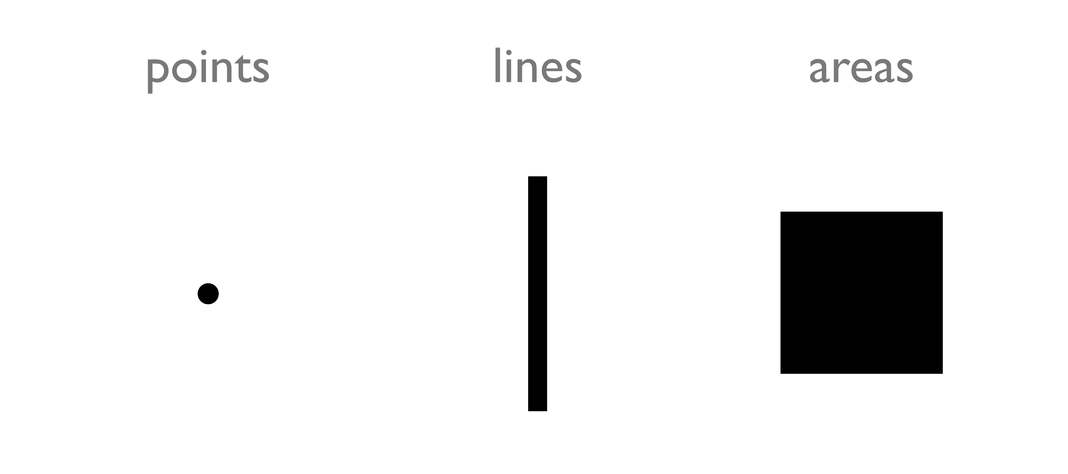
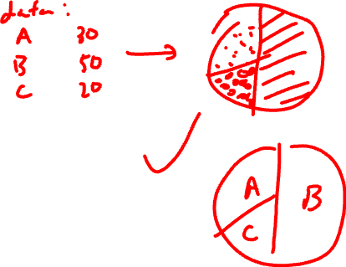
Types of encodings for different data types: Geometric Primitives
(Credit: Nils Gehlenborg, ISMB/ECCB 2011)

Slide 8
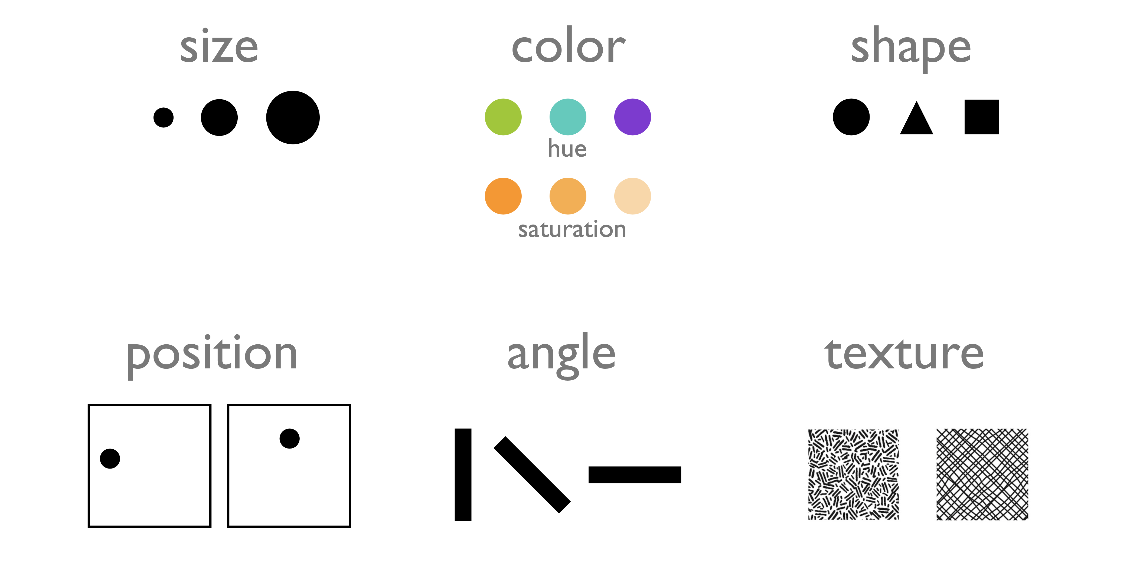
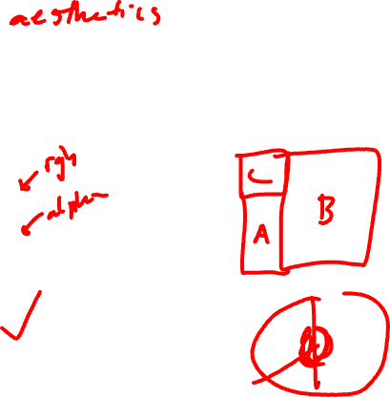
Types of encodings for different data types: Visual Channels (control geometric primitives)
(Credit: Nils Gehlenborg, ISMB/ECCB 2011)

Slide 9
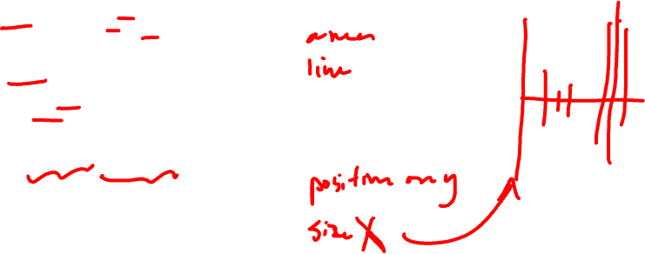
Data visualizations use combinations of geometric primitives and visual channels
Practice
Geometric primitive:
Visual channels:

Slide 10
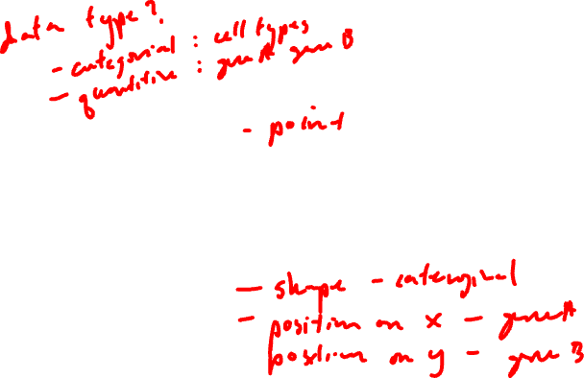
Data visualizations use combinations of geometric primitives and visual channels
Practice
Geometric primitive:
Visual channels:

Slide 11
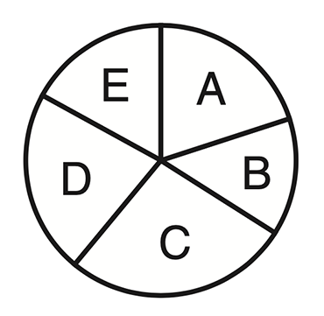
Data visualizations use combinations of geometric primitives and visual channels
Practice
Geometric primitive:
Visual channels:

Slide 12
Gestalt Principles
Gestalt Principles are an essential part of visual design (generally, not just data visualization)
There are more than ten overlapping principles
We will focus a few most applicable to data visualization
Basic on perception and cognitive psychology research

Slide 13
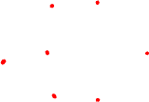
Gestalt Principle: Similarity
Items alike in their properties (size, shape, color, and so on) tend to be perceived as being a related group

Slide 14
Gestalt Principle: Similarity
Practice
Items alike in their properties (size, shape, color, and so on) tend to be perceived as being a related group
How does this data visualization use the Gestalt principle of similarity?

Slide 15
Gestalt Principle: Proximity
Items are near each other tend to be perceived as being a related group

Slide 16
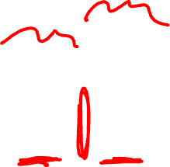
Gestalt Principle: Proximity
Practice
Items are near each other tend to be perceived as being a related group
How does this data visualization use the Gestalt principle of proximity?

Slide 17
Gestalt Principle: Enclosure
Items surrounded by something such as a line or an an object tend to be perceived as being a group

Slide 18

Gestalt Principle: Enclosure
Practice
Items surrounded by something such as a line or an an object tend to be perceived as being a group
How does this data visualization use the Gestalt principle of enclosure?

Slide 19
Gestalt Principle: Enclosure
Practice
Items surrounded by something such as a line or an an object tend to be perceived as being a group
How does this data visualization use the Gestalt principle of enclosure?

Slide 20
Gestalt Principle: Continuity
Elements tend to be perceived as smooth groups or continuous lines rather than sharp broken lines

Slide 21

Gestalt Principle: Continuity
Practice
Elements tend to be perceived as smooth groups or continuous lines rather than sharp broken lines
How does this data visualization use the Gestalt principle of continuity?

Slide 22
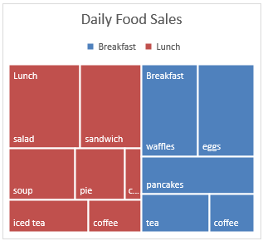
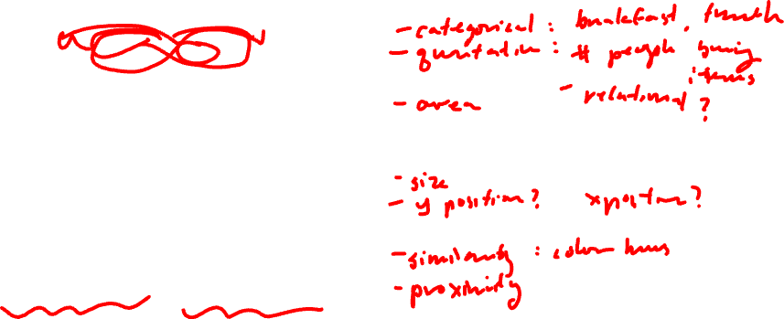
Data visualizations use combinations of geometric primitives and visual channels
Practice
Data Type:
Geometric primitive:
Visual channels:
Gestalt principles:

Slide 23
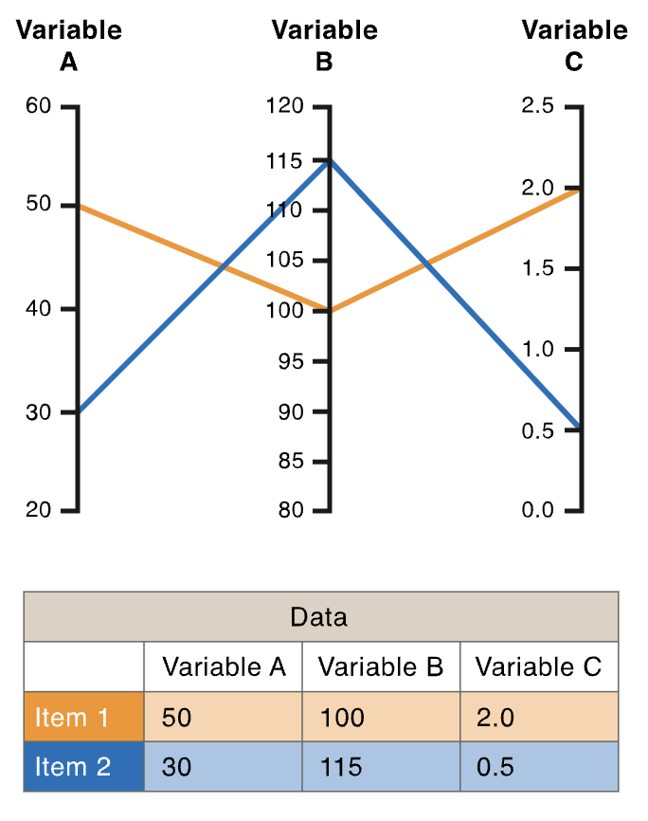
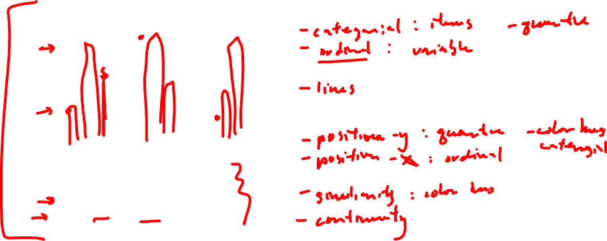
Data visualizations use combinations of geometric primitives and visual channels
Practice
Data Type:
Geometric primitive:
Visual channels:
Gestalt principles:

Slide 24
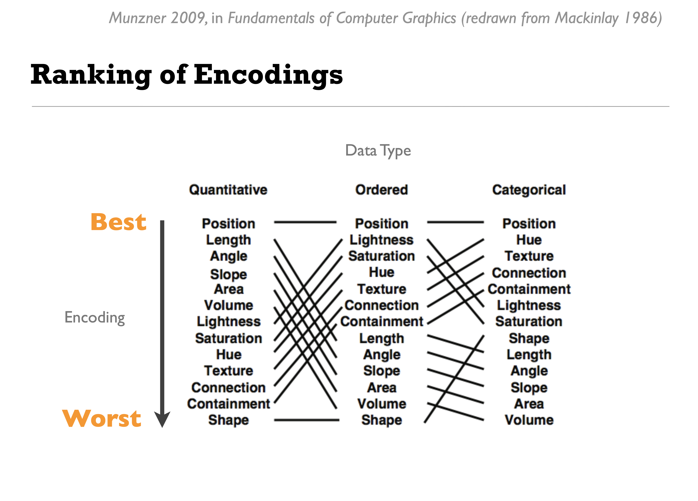
Human perception has a harder time resolving certain data encodings for different data types
(Credit: Nils Gehlenborg, ISMB/ECCB 2011)

Slide 25
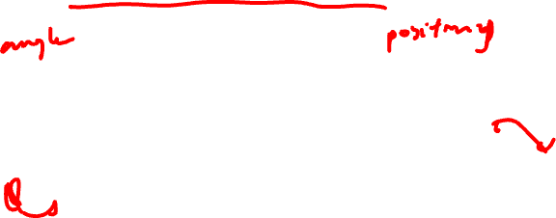
Demo: Which letter is more common?
(Credit: Bang Wong, Nature Methods, 2010)
Notes:
Different graph types depend on different visual assessments to uncover underlying trends. Pie charts are a common way to show parts of a whole. Most readers will likely judge angle when extracting information from pie charts, but they could also com- pare areas and arc length of the slices. Plotting the same data as a bar chart effectively shows relative values.

Slide 26
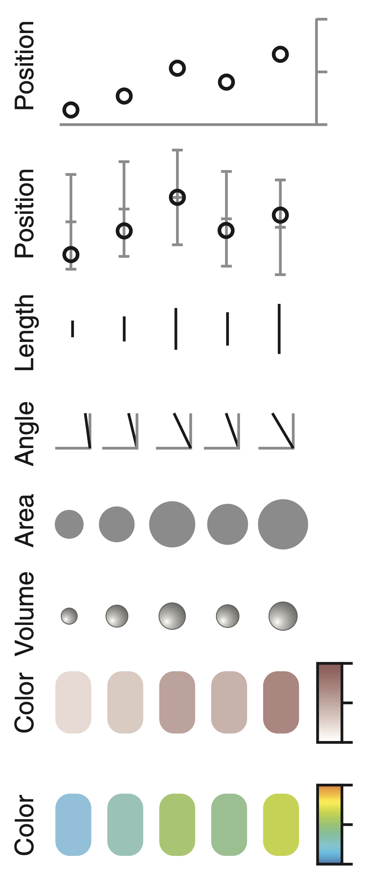
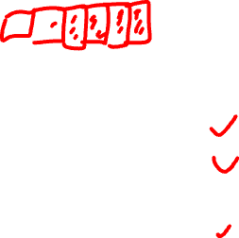
(Credit: Bang Wong, Nature Methods, 2010)

Slide 27
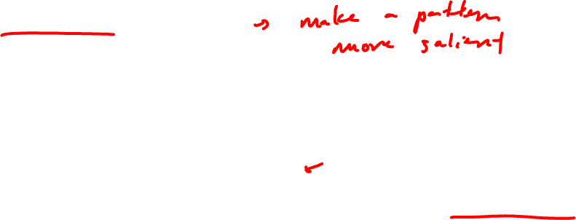
Salience
Salience (in data visualization) is how the viewer's eye is drawn to what is important in the data visualization
Enhanced saliency improves viewer understanding of the data
How accurately can the data be read from the visualization?
How many classes can be distinguished?
Can the visual properties and geometric primitives be separated from each other?
Which visual properties and geometric primitives are processed preattentively?
Which visual properties and geometric primitives encode more important information more effectively?
A good data visualization enhances saliency

Slide 28
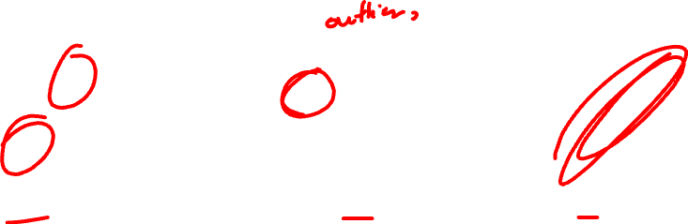

How do these different data visualizations enhance saliency of different features?
Practice

Slide 29
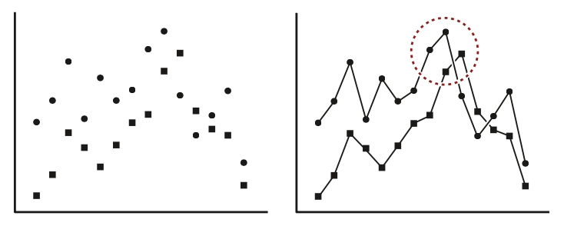
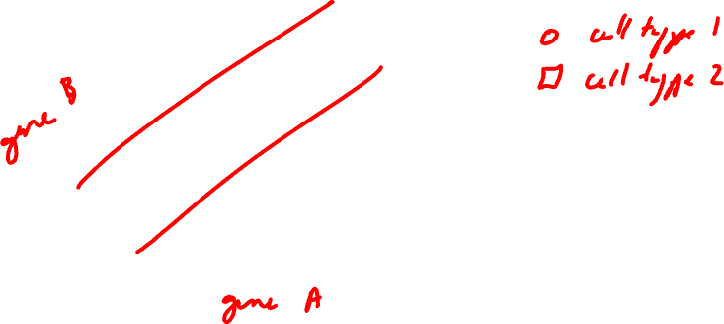
What’s your interpretation of this data visualization?
Practice

Slide 30
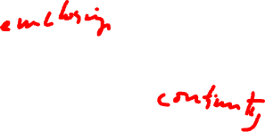
What about this one?
Practice
What gestalt principals are being applied?

Slide 31
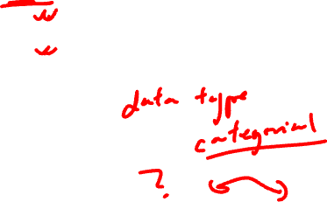
Practice
Which data visualization do you prefer? Why?

Slide 32

Practice
Which data visualization do you prefer? Why?

Slide 33
Practice

Slide 34

Is data visualization an art or a science?

Slide 35
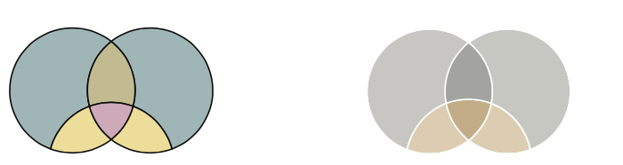
Which data visualization do you prefer? Why?
Practice
(Credit: Martin Krzywinski, Nature Methods 2013)

Slide 36
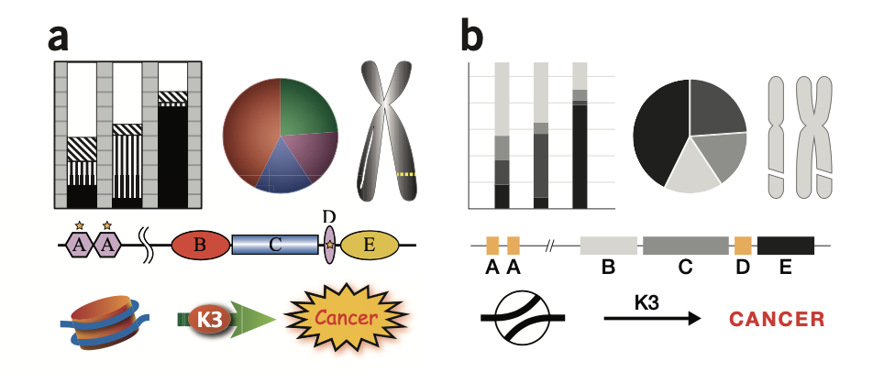
Which data visualization do you prefer? Why?
Practice
(Credit: Martin Krzywinski, Nature Methods 2013)

Slide 37
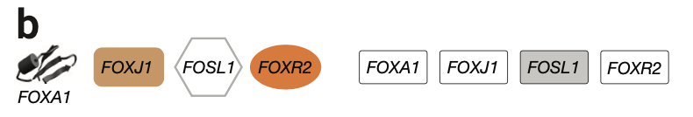
Which data visualization do you prefer? Why?
Practice
(Credit: Martin Krzywinski, Nature Methods 2013)

Slide 38
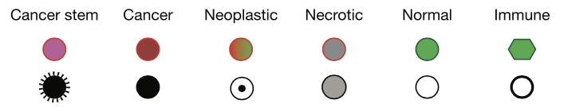
Which data visualization do you prefer? Why?
Practice
(Credit: Martin Krzywinski, Nature Methods 2013)

Slide 39
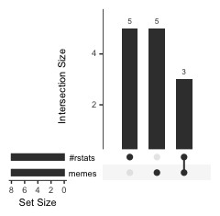
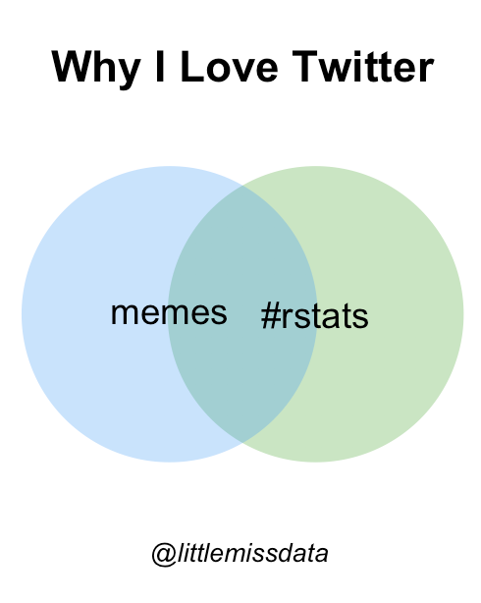
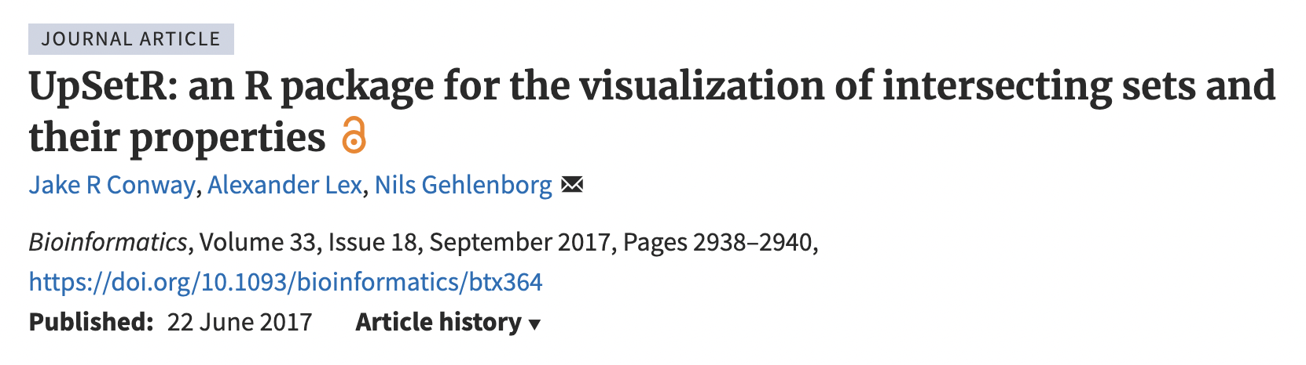
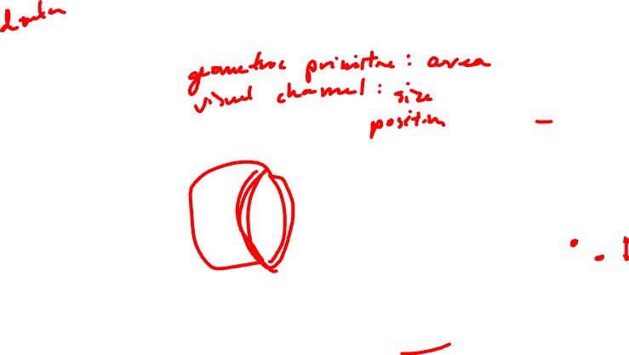
Which data visualization do you prefer? Why?
Practice
 | Memes | #Rstats
Student 1 | 1 | 0
Student 2 | 1 | 0
Student 3 | 1 | 0
Student 4 | 1 | 0
Student 5 | 1 | 0
Student 6 | 0 | 1
Student 7 | 0 | 1
Student 8 | 0 | 1
Student 9 | 0 | 1
Student 10 | 0 | 1
Student 11 | 1 | 1
Student 12 | 1 | 1
Student 13 | 1 | 1
https://www.littlemissdata.com/blog/set-analysis

Slide 40
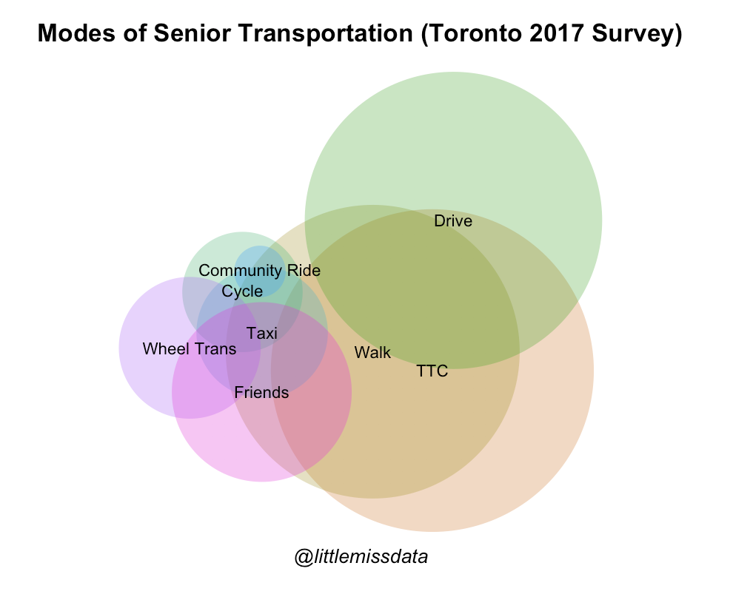
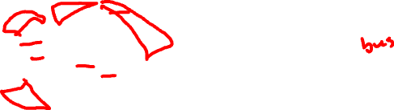
Which data visualization do you prefer? Why?
Practice
Do more seniors drive or walk?
Do more seniors walk AND drive only or TTC and drive only?
Do more seniors cycle only or taxi only?
https://www.littlemissdata.com/blog/set-analysis

Slide 41
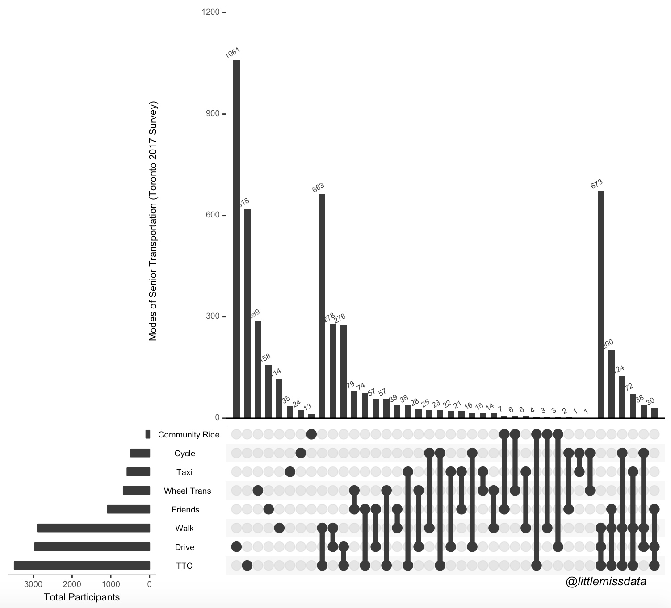
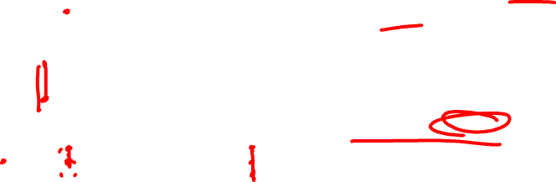
Practice
Do more seniors drive or walk?
Do more seniors walk AND drive only or TTC and drive only?
Do more seniors cycle only or taxi only?

Slide 42
Practice
https://www.littlemissdata.com/blog/set-analysis

Slide 43
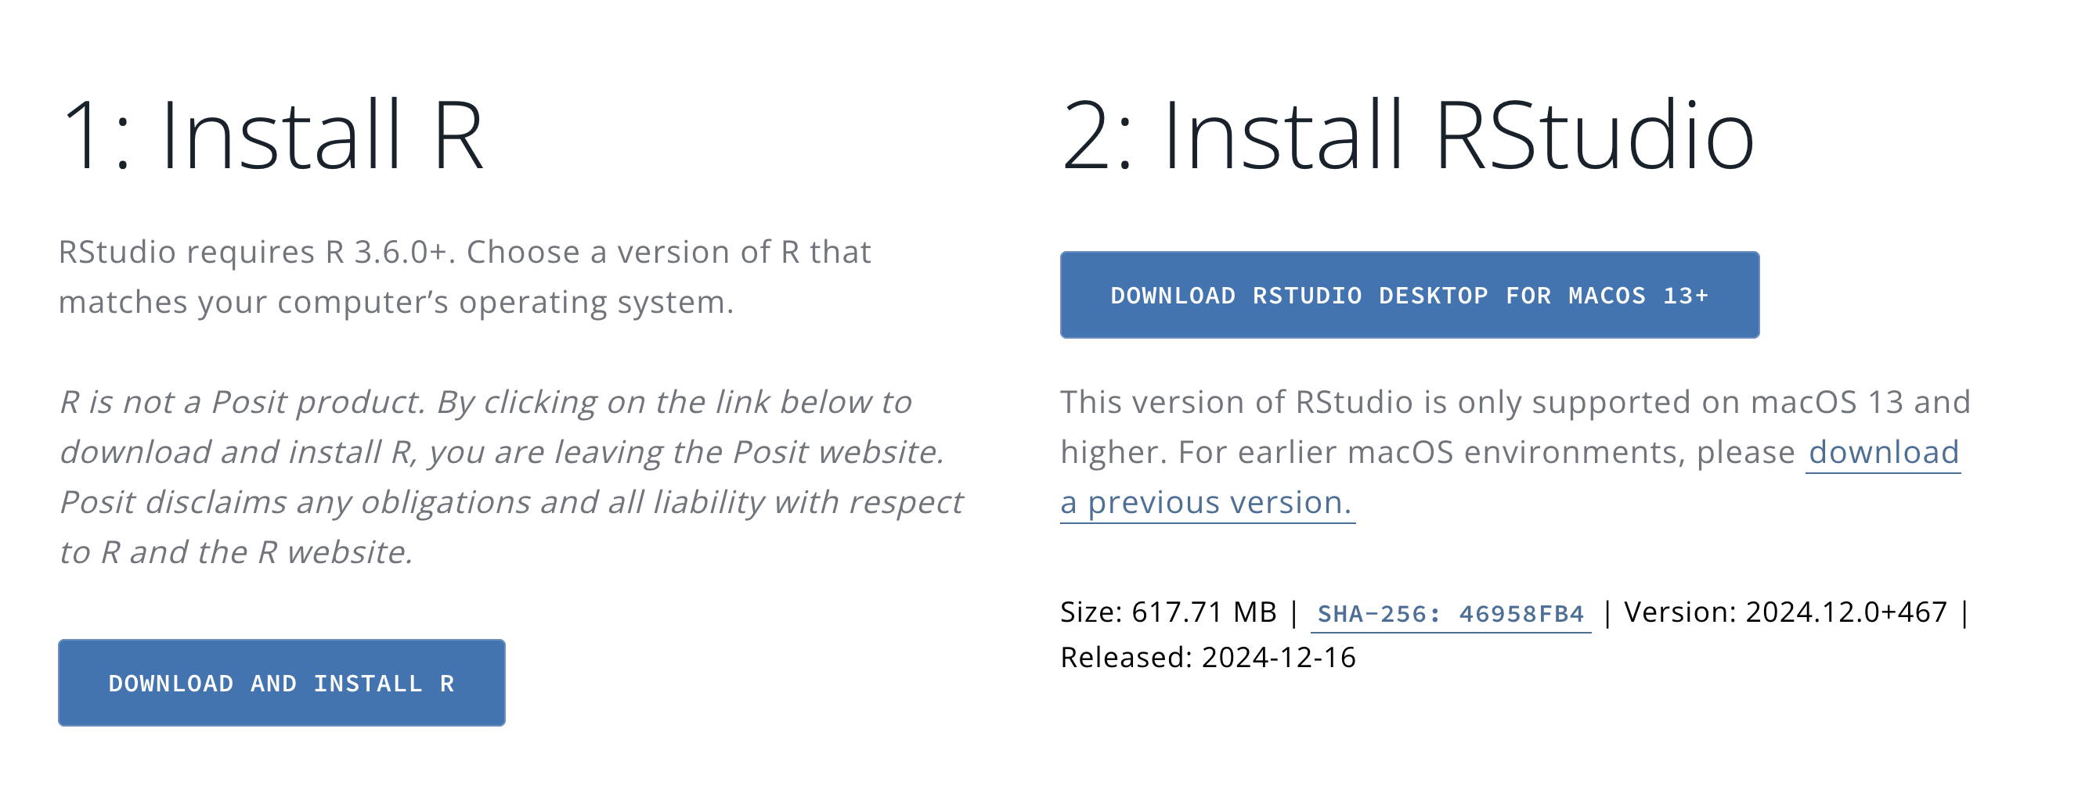
Hands-on Component: Getting started with R and R-Studio
https://posit.co/download/rstudio-desktop/

Slide 44
Reflection Cards on Canvas

